Slide 1

Term Deposit Prediction
Abi Sugiri
FTDS RMT 021

Slide 2

Introduction
Background
The Dataset
Objective

Slide 3
Steps
Loading/Preparing the Data
Exploratory Data Analysis (EDA)
Preprocessing
Defining ANN Model
Model Training
Model Evaluation
Model Improvement

Slide 4
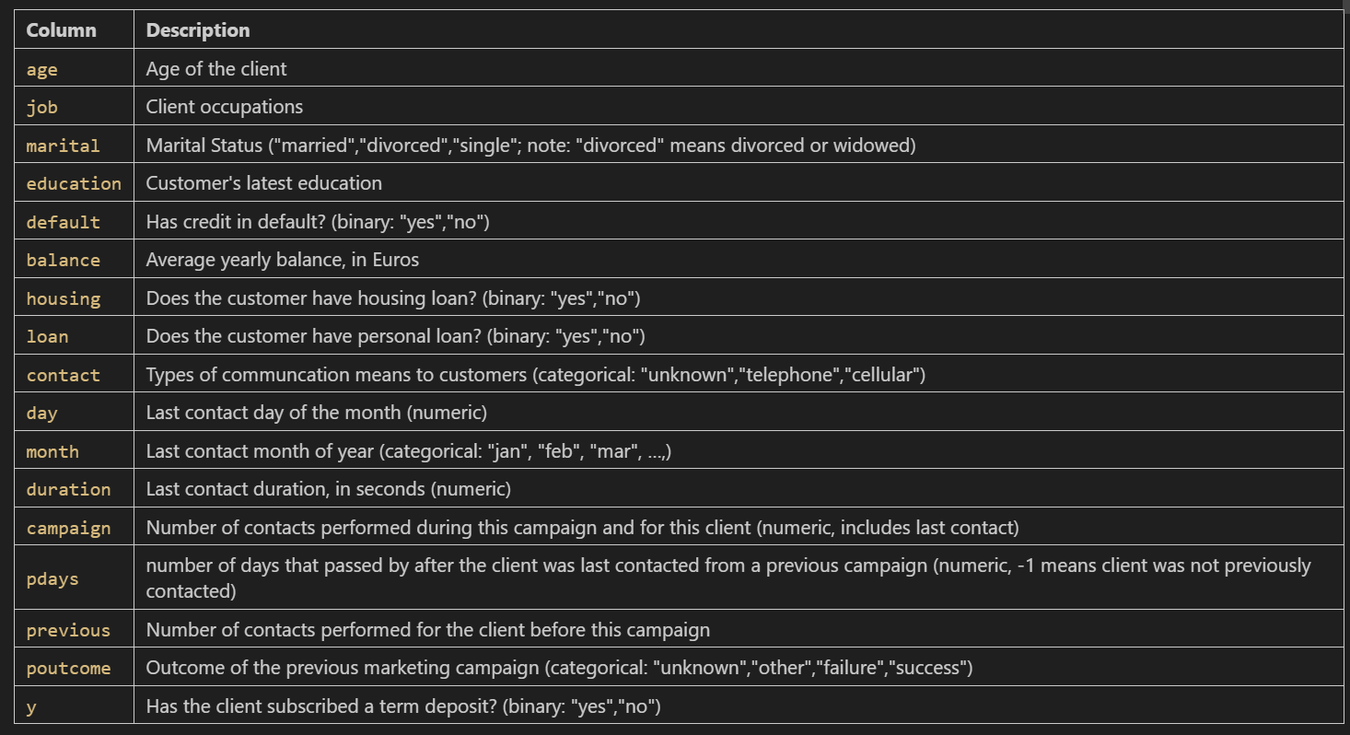

Slide 5

Exploratory Data Analysis
Checking data types and basic statistics
Checking for duplicated data
Checking for missing values
Analyzing data through Charts

Slide 6
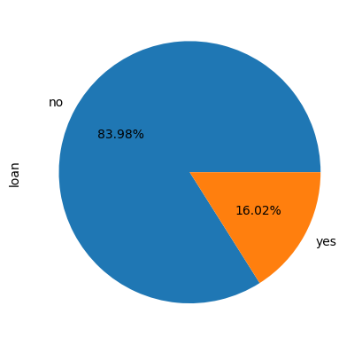
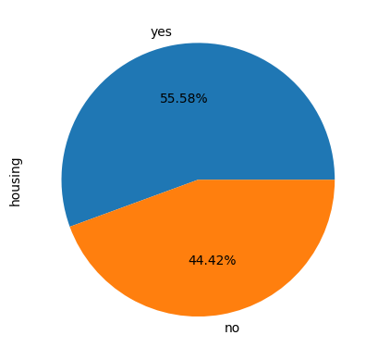
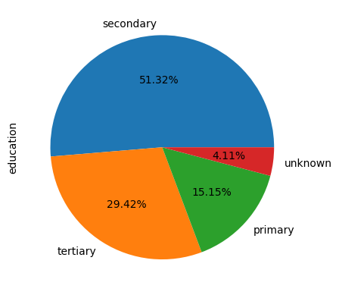
Pie Charts

Slide 7
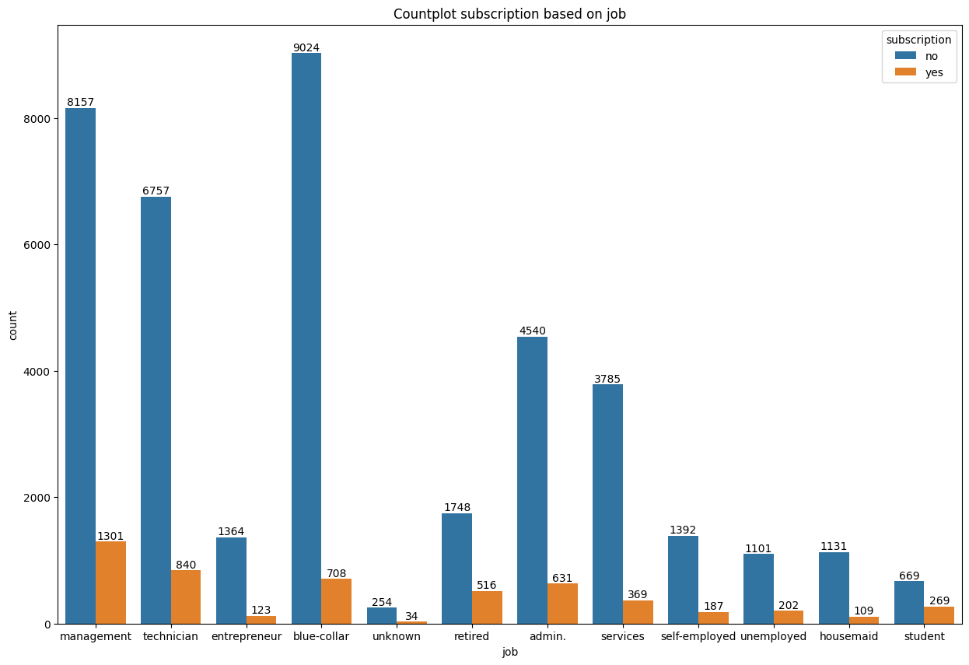

Slide 8
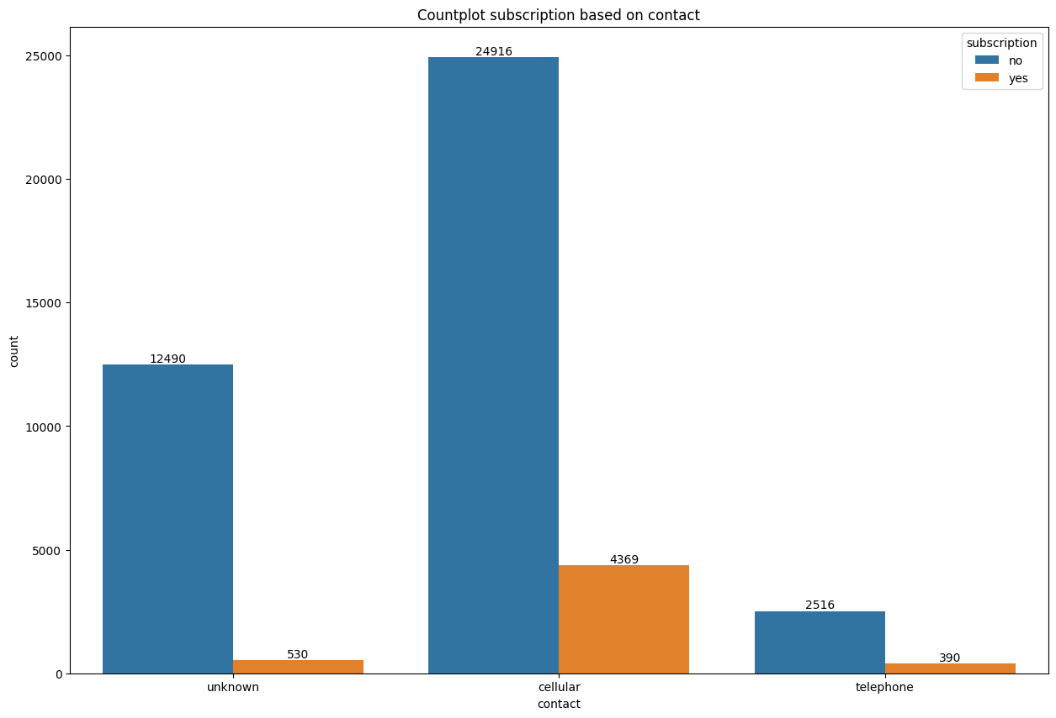

Slide 9
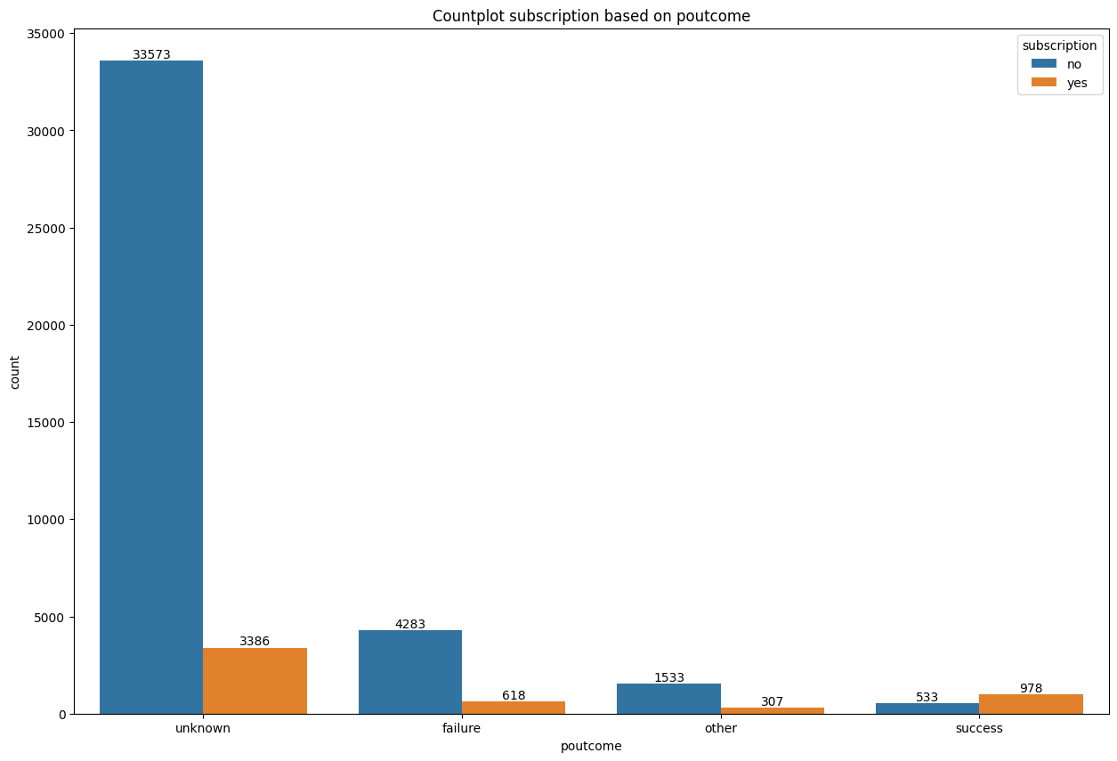
Bar chart based on previous campaign outcome

Slide 10
Preprocessing
Feature Selection
Splitting Data into X and y
Oversampling
Splitting dataset into numerical and categorical
Feature Scaling
Feature Encoding

Slide 11
Defining & Training the Model: Sequential API
3 hidden layers with HeNormal as initializer:
64 Neurons, axon = “relu”
32 Neurons, axon = “relu”
16 Neurons, axon = “relu”
Output layer: GlorotNormal as initializer and sigmoid for axon
Adam as optimizer
100 epochs

Slide 12
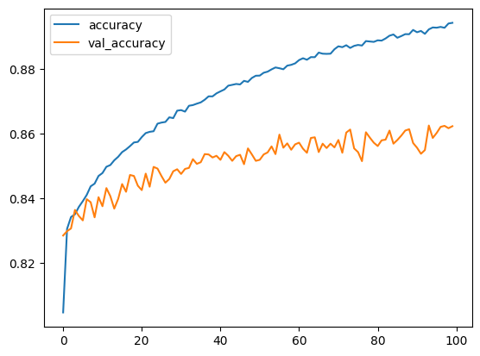
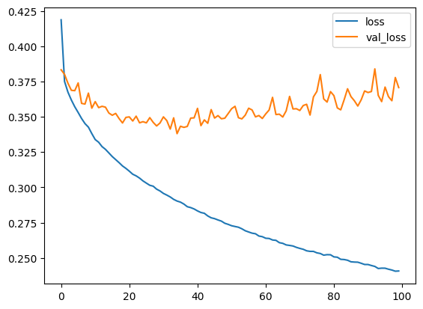
Model Evaluation

Slide 13
Dataset | Accuracy
Training Set | 0.89
Validation Set | 0.86
Test Set | 0.85

Slide 14

Model Improvement
Tuning parameters:
Adding 2 hidden layers
8 neurons
4 neurons
Changed the optimizer to “nadam”

Slide 15
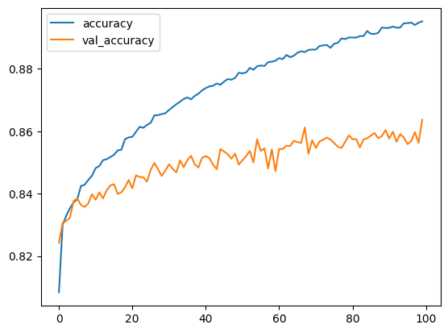
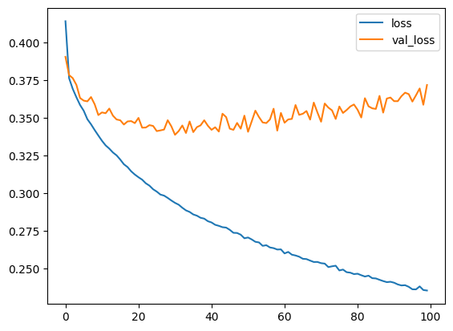
Model Evaluation

Slide 16
Dataset | Accuracy
Training Set | 0.90
Validation Set | 0.86
Test Set | 0.86

Slide 17
Conclusion

Slide 18
Thank You

